Slide 1
Types of Accounts

Slide 2
3 Types
Personal
Real
Nominal

Slide 3
Personal
Natural Person
Artificial Person
These accounts types are related to persons. These persons may be natural persons like Raj’s account, Rajesh’s account, Ramesh’s account, Suresh’s account, etc.
These persons can also be artificial persons like partnership firms, companies, bodies corporate, an association of persons, etc.
For example – Rajesh and Suresh trading Co., Charitable trusts, XYZ Bank Ltd, C company Ltd, etc.

Slide 4
Real
Tangible Real Accounts
These include assets that have a physical existence and can be touched. For example – Building A/c, cash A/c, stationery A/c, inventory A/c, etc.
Intangible Real Accounts
These assets do not have any physical existence and cannot be touched. However, these can be measured in terms of money and have value. For Example – Goodwill, Patent, Copyright, Trademark, etc.

Slide 5
Nominal
These accounts types are related to income or gains and expenses or losses. For example: – Rent A/c, commission received A/c, salary A/c, wages A/c, conveyance A/c, etc.

Slide 6
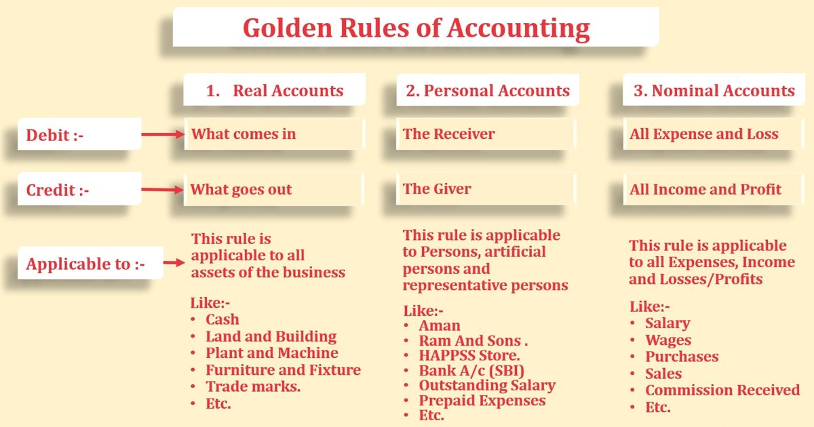
The golden rule

